Slide 1
Theory of Automata
Preliminaries
Nasreen Akhtar

Slide 2
Contents
Basic Definitions
  Languages, String, Words, Concatenation, Length
Palindrome
Kleene Closure
  Lexicographic order
  Definition
  Kleene Closure of null set & set with only null word
  Kleene Closure of different sets
  Positive Kleene Closure
  S**
Dr Aftab Maroof - Theory of Automata

Slide 3
Languages
In English, we distinguish 3 different entities: letters, words, and sentences.
  Groups of letters make up words and groups of words make up sentences.
  However, not all collections of letters form valid words, and not all collections of words form valid sentences.
This situation also exists with computer languages.
  Certain (but not all) strings of characters are recognizable words (e.g., IF, ELSE, FOR, WHILE …); and certain (but not all) strings of words are recognizable commands.
Nasreen Akhtar- Theory of Automata

Slide 4
To construct a general theory of formal languages, we need to have a definition of a language structure, in which the decision of whether a given string of units constitutes a valid larger unit is not a matter of guesswork, but is based on explicitly stated rules.
In this model, language will be considered as symbols with formal rules, and not as expressions of ideas in the minds of humans.
The term “formal” emphasizes that it is the form of the string of symbols that we are interested in, not the meaning.
Nasreen Akhtar- Theory of Automata

Slide 5
Basic Definitions
A finite non-empty set of symbols (letters), is called an alphabet. It is denoted by Σ ( Greek letter sigma).
Example:
Σ={a,b}
Σ={0,1} //important as this is the language //which the computer understands.
Σ={i,j,k}
Dr Aftab Maroof - Theory of Automata

Slide 6
Strings
What is a String?
Concatenation of finite symbols from the alphabet is called a string.
Example:
If Σ= {a,b} then
a, abab, aaabb, ababababababababab
Nasreen Akhtar- Theory of Automata

Slide 7
Words
What is a ‘word’?
Words are strings belonging to some language.
Example:
If Σ= {x} then a language L can be defined as
L={x^{n} : n=1,2,3,…..} or L={x,xx,xxx,….}
Here x,xx,… are the words of L
All words are strings, but not all strings are words.
Nasreen Akhtar- Theory of Automata

Slide 8
EMPTY STRING or NULL STRING
We shall allow a string to have no letters. We call this empty string or null string, and denote it by the symbol Λ.
For all languages, the null word, if it is a word in the language, is the word that has no letters. We also denote the null word by Λ.
Two words are considered the same if all their letters are the same and in the same order.
For clarity, we usually do not allow the symbol Λ to be part of the alphabet of any language.
Nasreen Akhtar- Theory of Automata

Slide 9
Discussion of null
The language that has no words is denoted by the standard symbol for null set, ø.
It is not true that Λ is a word in the language ø since this language has no words at all.
If a certain language L does not contain the word Λ and we wish to add it to L, we use the operation “+” to form L + {Λ}. This language is not the same as L.
However, the language L + ø is the same as L since no new words have been added.
Nasreen Akhtar- Theory of Automata

Slide 10
Introduction to Defining Languages
The rules for defining a language can be of two kinds:
  They can tell us how to test if a string of alphabet letters is a valid word, or
  They can tell us how to construct all the words in the language by some clear procedures.
Nasreen Akhtar- Theory of Automata

Slide 11
Defining Languages
Example: Consider this alphabet with only one letter
∑ = { x }
We can define a language by saying that any nonempty string of alphabet letters is a word
L₁ = { x, xx, xxx, xxxx, … } or
L₁ = { x^{n} for n = 1, 2, 3, … }
Note that because of the way we have defined it, the language L₁ does not include the null word Λ.
Nasreen Akhtar- Theory of Automata

Slide 12
Example:
The language L of strings of odd length, defined over Σ={a}, can be written as
L={a, aaa, aaaaa,…..}
Example:
The language L of strings that does not start with a, defined over Σ={a,b,c}, can be written as
L={b, c, ba, bb, bc, ca, cb, cc, …}
Nasreen Akhtar- Theory of Automata

Slide 13
Example:
The language L of strings of length 2, defined over Σ={0,1,2}, can be written as
L={00, 01, 02,10, 11,12,20,21,22}
Example:
The language L of strings ending in 0, defined over Σ ={0,1}, can be written as
L={0,00,10,000,010,100,110,…}
Nasreen Akhtar- Theory of Automata

Slide 14
Example:
The language EQUAL, of strings with number of a’s equal to number of b’s, defined over Σ={a,b}, can be written as
{Λ ,ab,aabb,abab,baba,abba,…}
The language EVEN-EVEN, of strings with even number of a’s and even number of b’s, defined over Σ={a,b}, can be written as
{Λ, aa, bb, aaaa,aabb,abab, abba, baab, baba, bbaa, bbbb,…}
Nasreen Akhtar- Theory of Automata

Slide 15
Concatenation
Let us define an operation, concatenation, in which two strings are written down side by side to form a new longer string.
xxx concatenated with xx is the word xxxxx
x^{n} concatenated with x^{m} is the word x^{n+m}
For convenience, we may label a word in a given language by a new symbol. For example,
xxx is called a, and xx is called b
Then to denote the word formed by concatenating a and b, we can write
ab = xxxxx
It is not true that when two words are concatenated, they produce another word. For example, if the language is
L₂ = {x, xxx, xxxxx, …} = {x^{2n+1} for n = 0, 1, 2, …}
then a = xxx and b = xxxxx are both words in L₂, but their concatenation ab = xxxxxxxx is not in L₂
Nasreen Akhtar- Theory of Automata
Notes:
Concatenate: to link together; unite in a series or chain.

Slide 16
Concatenation makes new Words?
Note that in this simple example, we have:
ab = ba
But in general, this relationship does NOT hold for all languages (e.g., houseboat and boathouse are two different words in English).
Example: Consider another language by beginning with the alphabet
∑ = { 0, 1, 2, 3, 4, 5, 6, 7, 8, 9 }
Define the language
L₃ = { any finite string of alphabet letters that does not start with the letter zero }
Nasreen Akhtar- Theory of Automata

Slide 17
This language L₃ looks like the set of positive integers:
L₃ = { 1, 2, 3, 4, 5, 6, 7, 8, 9, 10, 11, 12, … }
If we want to define L3 so that it includes the string (word) 0, we could say
L₃ = { any finite string of alphabet letters that, if it starts with a 0, has no more letters after the first}
Nasreen Akhtar- Theory of Automata

Slide 18
Definition: Length
We define the function length of a string to be the number of letters in the string.
Example:
  If a = xxxx in the language L₁, then length(a) = 4
  If c = 428 in the language L₃, then length(c) = 3
  If d = 0 in the language L₃, then length(d) = 1
  In any language that includes the null word Λ, then length(Λ) = 0
For any word w in any language, if length(w) = 0 then w = Λ.
Nasreen Akhtar- Theory of Automata

Slide 19
Recall that the language L₁ does not contain the null string Λ. Let us define a language like L₁ but that does contain Λ:
L₄ = { Λ, x, xx, xxx, xxxx, … }
= { x^{n} for n = 0, 1, 2, 3, … }
Here we have defined that
x⁰ = Λ (NOT x⁰ = 1 as in algebra)
In this way, x^{n} always means the string of n alphabet letters x’s.
Remember that even Λ is a word in the language, it is not a letter in the alphabet.
Nasreen Akhtar- Theory of Automata

Slide 20
Definition: Reverse
If a is a word in some language L, then reverse(a) is the same string of letters spelled backward, even if this backward string is not a word in L.
Example:
  reverse(xxx) = xxx
  reverse(145) = 541
  Note that 140 is a word in L₃, but reverse(140) = 041 is NOT a word in L₃
Nasreen Akhtar- Theory of Automata

Slide 21
Definition: Palindrome
Let us define a new language called Palindrome over the alphabet
∑ = { a, b }
PALINDROME = { Λ, and all strings x such that reverse(x) = x }
If we want to list the elements in PALINDROME, we find
PALINDROME = { Λ, a, b, aa, bb, aaa, aba, bab, bbb, aaaa, abba, … }
Nasreen Akhtar- Theory of Automata

Slide 22
Palindrome
Sometimes two words in PALINDROME when concatenated will produce a word in PALINDROME
  abba concatenated with abbaabba gives abbaabbaabba (in PALINDROME)
But more often, the concatenation is not a word in PALINDROME
  aa concatenated with aba gives aaaba (NOT in PALINDROME)
The language PALINDROME has interesting properties that we shall examine later.
Nasreen Akhtar- Theory of Automata

Slide 23
Task
Prove that there are as many palindromes of length 2n, defined over Σ = {a,b,c}, as there are of length 2n-1, n = 1,2,3… . Determine the number of palindromes of length 2n defined over the same alphabet as well.
Nasreen Akhtar- Theory of Automata

Slide 24
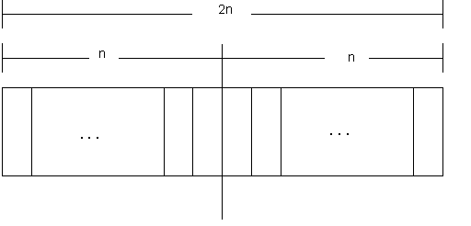
Solution
To calculate the number of palindromes of length(2n), consider the following diagram,
Nasreen Akhtar- Theory of Automata

Slide 25
which shows that there are as many palindromes of length 2n as there are the strings of length n i.e. the required number of palindromes are 3^{n} (as there are three letters in the given alphabet, so the number of strings of length n will be 3^{n} ).
Nasreen Akhtar- Theory of Automata

Slide 26
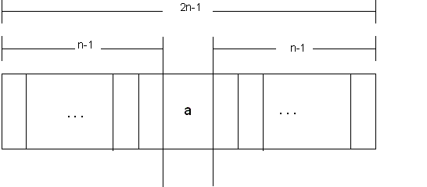
To calculate the number of palindromes of length (2n-1) with a as the middle letter, consider the following diagram,
Theory Of Automata
Nasreen Akhtar- Theory of Automata

Slide 27
which shows that there are as many palindromes of length 2n-1, with a as middle letter, as there are the strings of length n-1, i.e. the required number of palindromes are 3^{n-1}.
Similarly the number of palindromes of length 2n-1, with b or c as middle letter, will be 3^{n-1} as well. Hence the total number of palindromes of length 2n-1 will be
3^{n-1} + 3^{n-1} + 3^{n-1} = 3 (3^{n-1}) = 3^{n} .
Nasreen Akhtar- Theory of Automata

Slide 28
Kleene Closure
Definition: Given an alphabet ∑, we define a language in which any string of letters from ∑ is a word, even the null string Λ. We call this language the closure of the alphabet ∑, and denote this language by ∑*.
Examples:
If ∑ = { x } then ∑* = { Λ, x, xx, xxx, … }
If ∑ = { 0, 1 } then ∑* = { Λ, 0, 1, 00, 01, 10, 11, 000, 001, … }
If ∑ = { a, b, c } then
∑* = { Λ, a, b, c, aa, ab, ac, ba, bb, bc, ca, cb, cc, aaa, … }
Nasreen Akhtar- Theory of Automata

Slide 29
Lexicographic order
Notice that we listed the words in a language in size order (i.e., words of shortest length first), and then listed all the words of the same length alphabetically.
This ordering is called lexicographic order, which we will usually follow.
The star in the closure notation is known as the Kleene star.
We can think of the Kleene star as an operation that makes, out of an alphabet, an infinite language (i.e., infinitely many words, each of finite length).
Nasreen Akhtar- Theory of Automata

Slide 30
Kleene Closure
Let us now generalize the use of the Kleene star operator to sets of words, not just sets of alphabet letters.
Definition: If S is a set of words, then S* is the set of all finite strings formed by concatenating words from S, where any word may be used as often as we like, and where the null string Λ is also included.
Nasreen Akhtar- Theory of Automata

Slide 31
Kleene Closure
Example: If S = { aa, b }
Nasreen Akhtar- Theory of Automata

Slide 32
Kleene Closure
Example: If S = { aa, b } then
S* = { Λ plus any word composed of factors of aa and b }, or
S* = { Λ plus any strings of a’s and b’s in which the a’s occur in even clumps }, or
S* = { Λ, b, aa, bb, aab, baa, bbb, aaaa, aabb, baab, bbaa, bbbb, aaaab, aabaa, aabbb, baaaa, baabb, bbaab, bbbaa, bbbbb, … }
Note that the string aabaaab is not in S* because it has a clump of a’s of length 3.
Nasreen Akhtar- Theory of Automata

Slide 33
Kleene Closure
Example: Let S = { a, ab }
Nasreen Akhtar- Theory of Automata

Slide 34
Kleene Closure
Example: Let S = { a, ab }. Then
S* = { Λ plus any word composed of factors of a and ab },
Or
S* = { Λ plus all strings of a’s and b’s except those that start with b and those that contain a double b },
Or
S* = { Λ, a, aa, ab, aaa, aab, aba, aaaa, aaab, abaa, abab, aaaaa, aaaab, aaaba, aabaa, aabab, abaaa, abaab, ababa, … }
Note that for each word in S*, every b must have an a immediately to its left, so the double b, that is bb, is not possible; neither any string starting with b.
Nasreen Akhtar- Theory of Automata

Slide 35
How to prove a certain word is in the closure language S*
We must show how it can be written as a concatenation of words from the base set S.
In the previous example, to show that abaab is in S*, we can factor it as follows:
abaab = (ab)(a)(ab)
These three factors are all in the set S, therefore their concatenation is in S*.
Note that the parentheses, ( ), are used for the sole purpose of demarcating the ends of factors.
Nasreen Akhtar- Theory of Automata

Slide 36
Observe that if the alphabet has no letters, then its closure is the language with the null string as its only word; that is
if ∑ = ø (the empty set), then ∑* = { Λ }
Also, observe that if the set S has the null string as its only word, then the closure language S* also has the null string as its only word; that is
if S = { Λ }, then S* = { Λ }
because ΛΛ = Λ.
Hence, the Kleene closure always produces an infinite language unless the underlying set is one of the two cases above.
Nasreen Akhtar- Theory of Automata

Slide 37
Kleene Closure of different sets
The Kleene closure of two different sets can end up being the same language.
Example: Consider two sets of words
S = { a , b, ab } and T = { a, b, bb }
Then, both S* and T* are languages of all strings of a’s and b’s since any string of a’s and b’s can be factored into syllables of (a) or (b), both of which are in S and T.
Nasreen Akhtar- Theory of Automata

Slide 38
Positive Closure
If we wish to modify the concept of closure to refer only the concatenation of some (not zero) strings from a set S, we use the notation + instead of *.
This “plus operation” is called positive closure.
Example: if ∑ = { x } then ∑⁺ = { x, xx, xxx, … }
Observe that:
If S is a language that does not contain Λ, then S⁺ is the language S* without the null word Λ.
If S is a language that does contain Λ, then S⁺ = S*
Likewise, if ∑ is an alphabet, then ∑⁺ is ∑* without the word Λ.
Nasreen Akhtar- Theory of Automata

Slide 39
S**?
What happens if we apply the closure operator twice?
  We start with a set of words S and form its closure S*
  We then start with the set S* and try to form its closure, which we denote as (S*)* or S**
Theorem 1:
For any set S of strings, we have S* = S**
Before we prove the theorem, recall from Set Theory that
  A = B if A is a subset of B and B is a subset of A
  A is a subset of B if for all x in A, x is also in B
Nasreen Akhtar- Theory of Automata

Slide 40
Proof of Theorem 1:
Let us first prove that S** is a subset of S*:
Every word in S** is made up of factors from S*. Every factor from S* is made up of factors from S. Hence, every word from S** is made up of factors from S. Therefore, every word in S** is also a word in S*. This implies that S** is a subset of S*.
Let us now prove that S* is a subset of S**:
In general, it is true that for any set A, we have a subset A*, because in A* we can choose as a word any factor from A. So if we consider A to be our set S* then S* is a subset of S**
Together, these two inclusions prove that S* = S**.
Nasreen Akhtar- Theory of Automata

Slide 41
TASK
Consider the language S*, where S = {a, b}. How many words does this language have of length 2? of length 3? of length n?
Consider the language S*, where S = {aa, b}. How many words does this language have of length 4? of length 5? of length 6? What can be said in general?
Consider the language S*, where S = {ab, ba}. Write out all the words in S* that have seven or fewer letters. Can any word in this language contain the substrings aaa or bbb?
Nasreen Akhtar- Theory of Automata

Slide 42
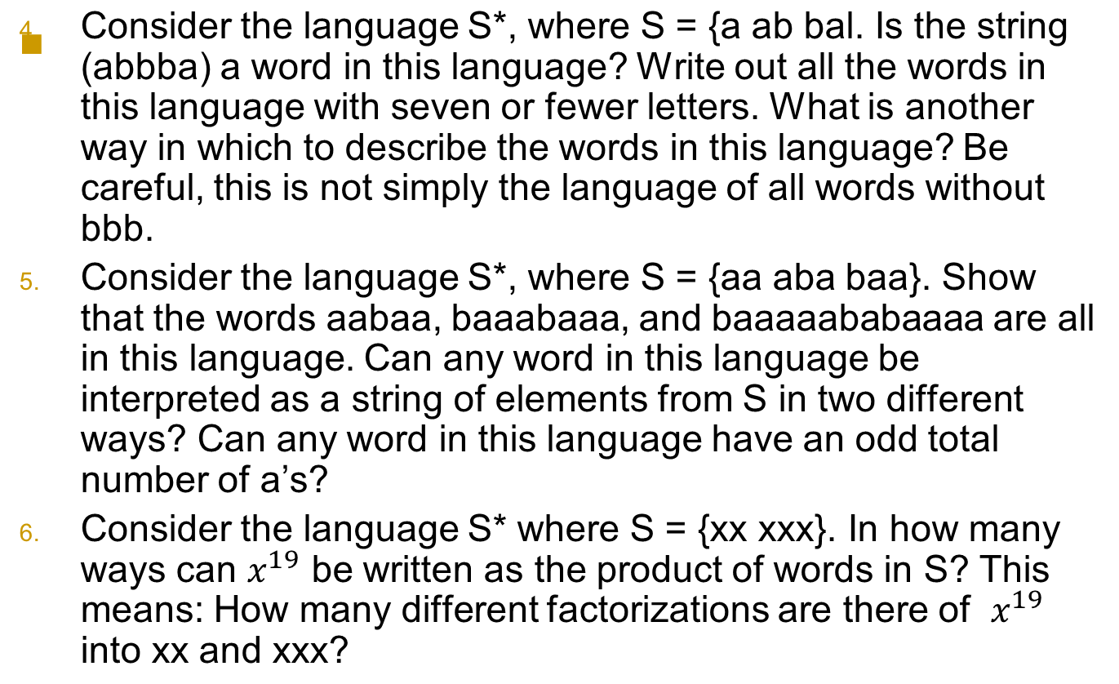
TASK
Nasreen Akhtar- Theory of Automata

